Slide 1
School of
Engineering and Computer Science
Te Kura Mātai Pūkaha, Pūrorohiko
CYBR 271 T2 2020 Secure Programming
Ian Welch, Harith Al-Sahaf
Buffer Overflow – Attacks
Du, Wenliang, “Computer & Internet Security: A Hands-on Approach”, 2nd ed, 2019 (Chapter 4)

Slide 2
Outline
Buffer overflow: A brief history
Memory layout and stack
Vulnerable code
Challenges in exploitation

Slide 3
Buffer Overflow: A Brief History
One of the classic and mostly common vulnerability in software
A programming bug allows a buffer to extend beyond its defined length
First documentation of a buffer overflow attack is in 1972
Buffer overflows exploited in the wild since at least the 1988 Morris Internet worm
How it works (high-level)
Overflowing a buffer overwrites meta data that is used to control the instruction pointer
Arbitrary code in the buffer, “shellcode”, can execute if the instruction pointer redirects here
How it works (low-level)
This lecture

Slide 4
Virtual address vs Physical address
Q: what will happen if we try to fetch data from an address that is not mapped?

Slide 5
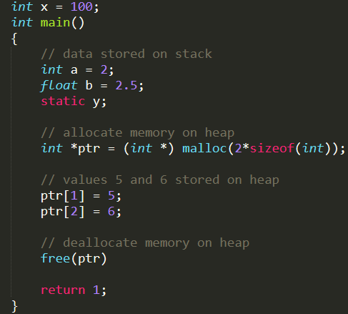
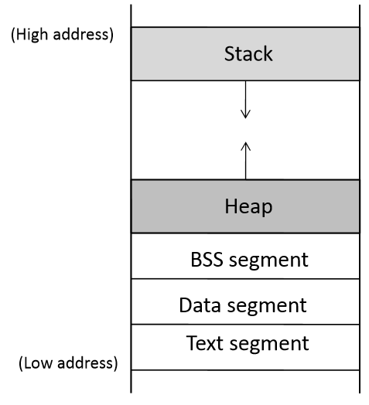
Program memory stack (memory layout)
Global variables are stored in Data segment.
Uninitialized static variables are stored in BSS.
Dynamic memory is allocated in heap.
Local variables are stored in Stack.
We will examine the stack layout more carefully
a,b, ptr
ptr points to the memory here
y
x

Slide 6
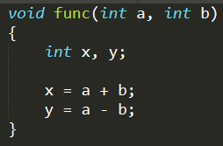
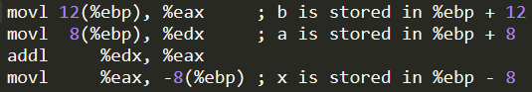
Function arguments and local variables
Stack frame
Frame Pointer
Stack Frame

Slide 7
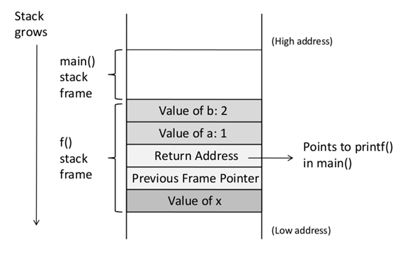
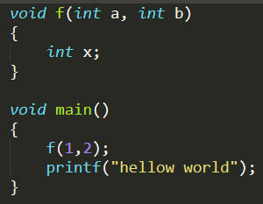
Function-call stack

Slide 8
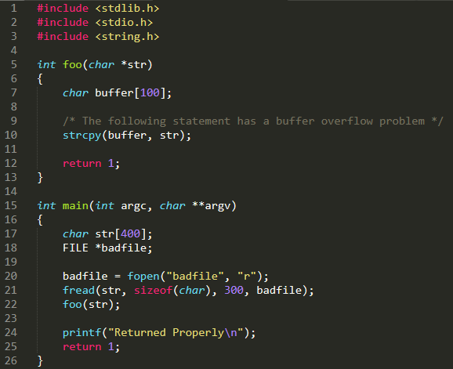
Stack layout for function-call chain
main() foo() strcpy()

Slide 9
Copy Data to Buffer
Copy data
From: src (buffer)
To: dest (buffer)
“\0” ≠ “0”
Ascii 0 (48) vs binary 0 (0x30)
memcpy()
When to stop in strcpy()?
Other functions?

Slide 10
Buffer overflow example
Q: what will be the subsequence of overwriting “Return Address” and “Previous Frame Pointer”?

Slide 11
Consequences of buffer overflow
Overwriting return address with some random address can point to :
Invalid/non-existing address (mapped address)
Invalid instruction
Access violation (valid instruction, but kernel)
Attacker’s code Malicious code to gain access

Slide 12
What can we do?
How to get our code to be executed

Slide 13
A vulnerable program
Set-UID

Slide 14

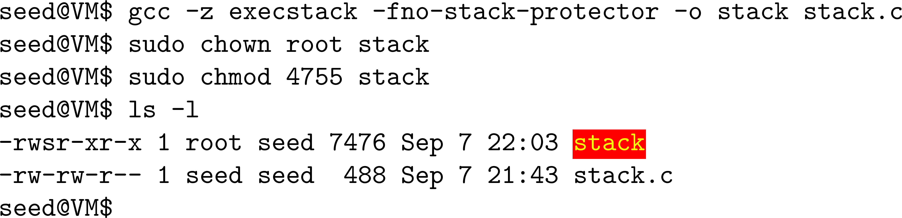
Environment setup
Turn off address randomisation (countermeasure)
Compile Set-UID root version of stack.c
Non-executable stack
Stack guard

Slide 15
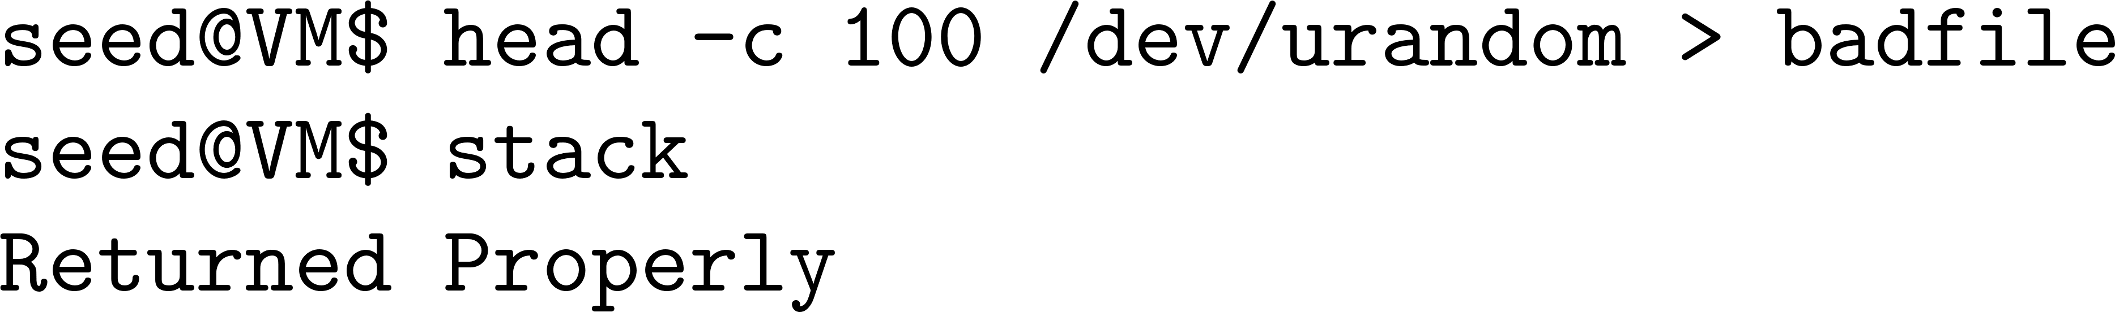
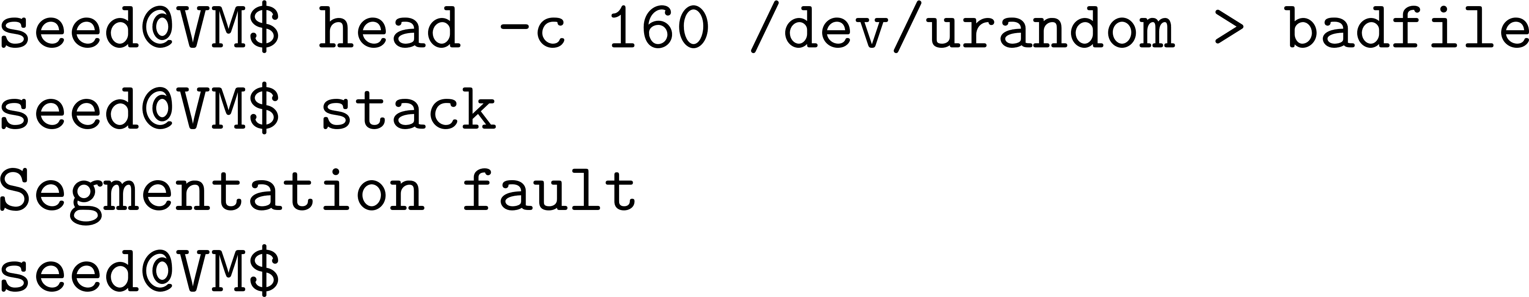
Environment setup (cont.)
Execution

Slide 16
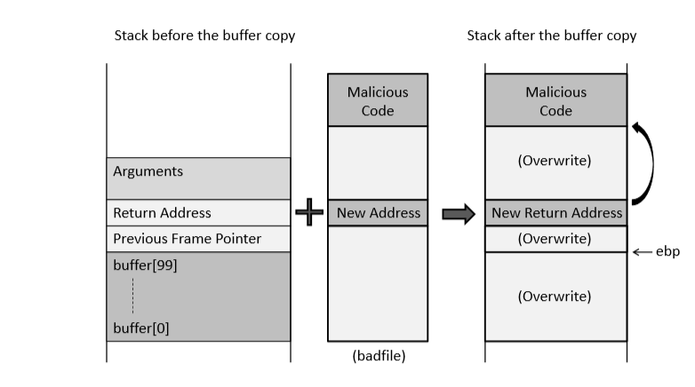
How to run malicious code
We control the input only

Slide 17
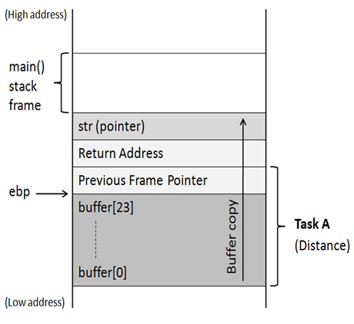
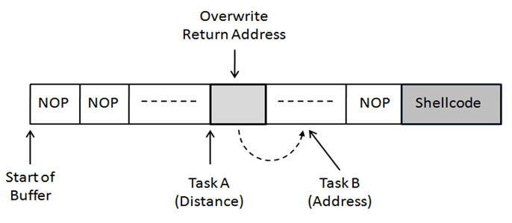
Creation of The Malicious Input (badfile)
Task A:
Find the offset distance between the base of the buffer and return address.
Task B:
Find the address to place the shellcode.

Slide 18
Task A: Find the offset
Running GDB
Finding the address
For debugging purpose
Therefore, the distance is 108 + 4 = 112

Slide 19
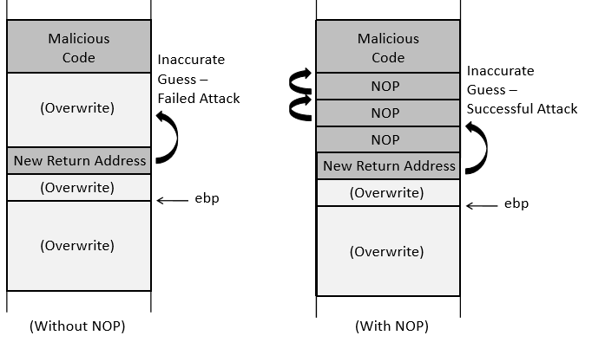
Task B: Address of Malicious Code
To increase the chances of jumping to the correct address, of the malicious code, we can fill the badfile with NOP (0x90) instructions and place the malicious code at the end of the buffer.
Note : NOP- Instruction that does nothing.

Slide 20
Constructing the payload/input (badfile)
execve(“/bash/sh”,…)
What do you want to put here?

Slide 21
Important notes/questions
Is ebp+8 enough?
Can we have ‘0’ in the payload?

Slide 22
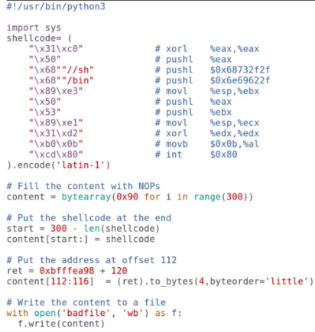
Writing the exploit code

Slide 23
Summary
Buffer overflow is a common security flaw
We only focused on stack-based buffer overflow
Heap-based buffer overflow can also lead to code injection
Exploit buffer overflow to run injected code
Next
The malicious code
Countermeasures
How can we defeat the countermeasures?

